Slide 1
BITWISE ALGORITHMS

Slide 2
Binary Palindrome
Write a program to check if the binary representation of a number is palindrome or not.
Input: 9
Output: Yes
9 = (1001)
A palindrome is a sequence that is same both forwards and backwards. The binary representation of a number is checked for being a palindrome but no leading 0’s are considered

Slide 3
Algorithms
1. Find number of bits in x using sizeof() operator.
2. Initialize left and right positions as 1 and n respectively.
3. Do following while left ‘l’ is smaller than right ‘r’.
(a) If bit at position ‘l’ is not same as bit at position ‘r’, then return false.
(b) Increment ‘l’ and decrement ‘r’, i.e., do l++ and r–-.
4. If we reach here, it means we didn’t find a mismatching bit.
To find the bit at a given position, we can use the idea similar to this post. The expression “x & (1 << (k-1))” gives us non-zero value if bit at k’th position from right is set and gives a zero value if if k’th bit is not set.

Slide 4
Booth’s algorithm
• Booth's multiplication algorithm is an algorithm which multiplies 2 signed or unsigned integers in 2's complement.
• This approach uses fewer additions and subtractions than more straightforward algorithms

Slide 5
Booth’s algorithm
• Firstly take two registers Q and M
• Load multiplicand and multiplier in this registers
• For eg., In 4 * 5 , 4 is multiplicand and 5 is multiplier
• We also need third register A, which is initialize to 0(zero).
• We also need a register to store carry bit resulting from addition. Hence, we take one bit register Q-1
• Multiplicand(M) is added to register Q and the result is stored in register A
• Then all bits of the A,Q,Q-1 are shifted to the right one bit.
• Depending upon last bit of Q and single bit of Q-1 following arithmetic operations are performed

Slide 6
Points to remember(for unsigned)
• Possible arithmetic actions:
• 00 -> no arithmetic operation
• 01 -> add multiplicand to left half of product
• 10 -> subtract multiplicand from left half of product
• 11 -> no arithmetic operation

Slide 7
Points to remember (for signed)
Firstly signed integers is converted into unsigned using 2’s complement
Then its is loaded in registers.
Example
2’s compliment of (-5)
Binary:- 0111
1’s compliment:- 1000
+ 1
-------------------------------------------
2’s compliment:- 1001

Slide 8
Binary subtraction
Following are the possibilities in binary subtraction.
• 1-0--> 1
• 1-1--> 0
• 0-1--> 1 with carry 1
• 0-0--> 0
Example:
• (1) 00000 (left half of product)
• -00010 (mulitplicand)
• 11110 (uses a phantom borrow)

Slide 9
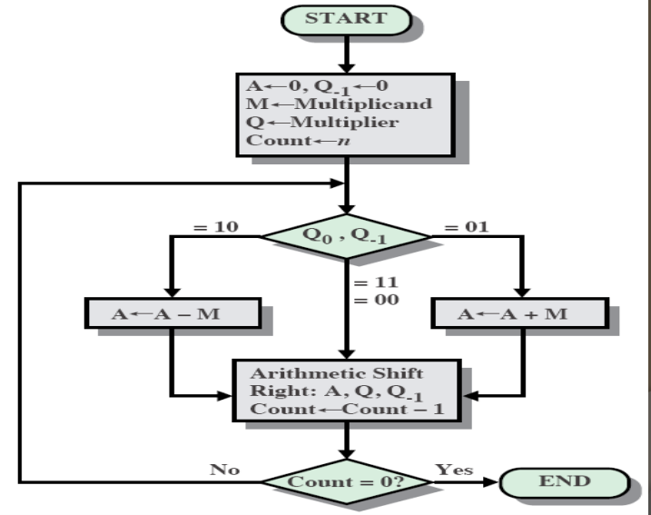
Flowchart

Slide 10
Euclidean Algorithm
• The Euclidean Algorithm to find GCD(a, b) relies upon replacing one of a or b with the remainder after division.
• Thus the numbers we seek the GCD of are steadily becoming smaller and smaller. We stop when one of them becomes 0.
• Specifically, we assume that a is larger than b. If b is larger than a, then we swap them around so that a becomes the old b and b becomes the old a.
• We then look for numbers q and r so that a=bq+r. They must have the properties that q≥0 and 0≤r<b.
• In other words, we seek the largest such q.

Slide 11
Euclidean Algorithm
As examples, consider the following.
• a=12, b=5; 12=5*2+2 so q=2, r=2
• a=24, b=18; 24=18*1+6 so q=1, r=6
• a=30, b=15; 30=15*2+0 so q=2, r=0
• a=27, b=14; 27=14*1+13 so q=1, r=13
Try the ones on the next slide.

Slide 12
Euclidean Algorithm
Find q and r for the following sets of a and b. The answers are on the next slide.
• a=28, b=12
• a=50, b=30
• a=35, b=14
• a=100, b=20

Slide 13
Euclidean Algorithm
Answers:
• q=2, r=4
• q=1, r=20
• q=2, r=7
• q=5, r=0

Slide 14
Euclidean Algorithm
• The algorithm works in the following way.
• Given a and b, we find numbers q and r so that a=bq+r.
• We make sure that q is as large as possible (≥0), and 0≤r<b.
• For example, if a=18, b=12, then we write 18=12*1+6.
• Actually the number q isn’t important, it is just easier to find r with it when solving problems by hand. Most software can find the remainder r without finding q.
• For example the Java statement below will find r.
• r=a%b;

Slide 15
Euclidean Algorithm
• Once the remainder r has been found we replace a by b and b by r.
• This relies on the fact that GCD(a,b)=GCD(b,r).
• Hence we repeatedly find r, the remainder after a is divided by b.
• Then replace a by b and b by r, and keep on in this way until r=0.
• Let us look at a graphical interpretation of the Euclidean algorithm.
• Obviously if p=GCD(a,b) then p|a and p|b, that is to say p divides both a and b evenly with no remainder.

Slide 16
Euclidean Algorithm
• Hopefully it will be clear that by now any number that divides both a and b must also divide the remainder r.
• The largest of these will of course be the GCD of a and b.
• So GCD(a,b)=GCD(b,r).

Slide 17
Karatsuba Algorithm
• Fast multiplication algorithm reduces the multiplication of two n-digit numbers to at most 3 n log 2 3 approx 3 n 1.585 single-digit multiplications in general.
• It operates in O(n^log2(3)) time (~ O(n^1.585)), with n being the number of digits of the numbers we are multiplying together.
• Standard grade-school multiplication operates in O(n^2) time. Karatsuba's method is asymptotically much faster.
• Normally, you can choose any base you want, but we will be using base 10 in this algorithm with m varying depending on the length of the inputs.
• Specific details are included with an example in the comments before the actual method.

Slide 18
Algorithm Steps:
• Compute starting set (a*c)
• Compute set after starting set may it be ending set (b*d)
• Compute starting set with ending sets
• Subtract values of step 3 from step2 from step1
• Pad up (Add) 4 zeros to the number obtained from Step1, step2 value unchanged, and pad up two zeros to value obtained from step4.

Slide 19
Longest Sequence of 1 after flipping a bit
Give an integer n. We can flip exactly one bit. Write code to find the length of the longest sequence of 1 s you could create.
Input:
1775
Output:
8
Binary representation of 1775 is 11011101111.
After flipping the highlighted bit, we get consecutive 8 bits.
11011111111.

Slide 20
Longest Sequence of 1 after flipping a bit
Solution is to walk through the bits in binary representation of given number. We keep track of current 1’s sequence length and the previous 1’s sequence length. When we see a zero, update previous Length:
If the next bit is a 1, previous Length should be set to current Length.
If the next bit is a 0, then we can’t merge these sequences together. So, set previous Length to 0.
We update max length by comparing following two:
Current value of max-length
Current-Length + Previous-Length .
result = return max-length+1 (// add 1 for flip bit count)

Slide 21
Swap two nibbles in a byte
Four bit aggregation or half an octet one byte has 8 bits or 2 nibbles
For example 100 is be represented as 01100100 in a byte (or 8 bits).
The two nibbles are (0110) and (0100). If we swap the two nibbles, we get 01000110 which is 70 in decimal.
Input: 01100100
Output: 01000110
We use bitwise operators to swap two nibbles in a byte

Slide 22
Thank You …

